Slide 1

Updating License Information
City of South Padre Island, tx

Slide 2
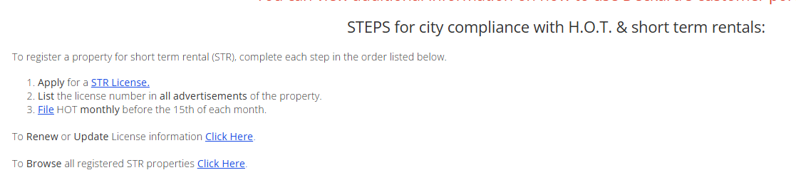
www.myspi.org/hottax

Slide 3
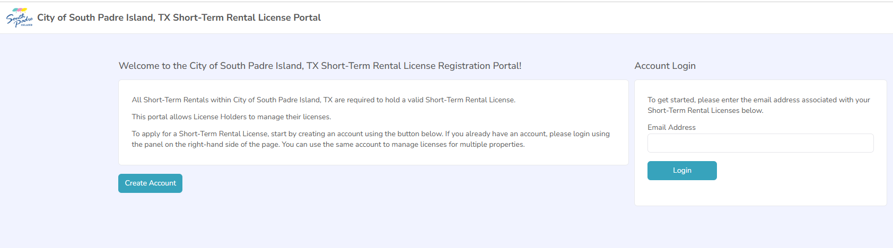
Updating License Information
Enter your email address and click on Login

Slide 4
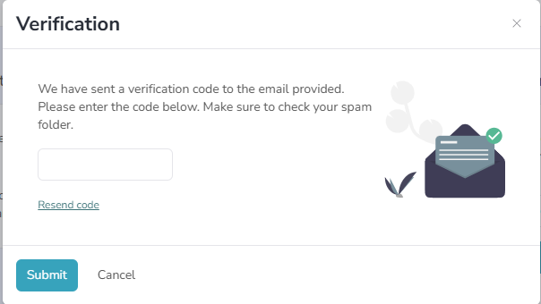
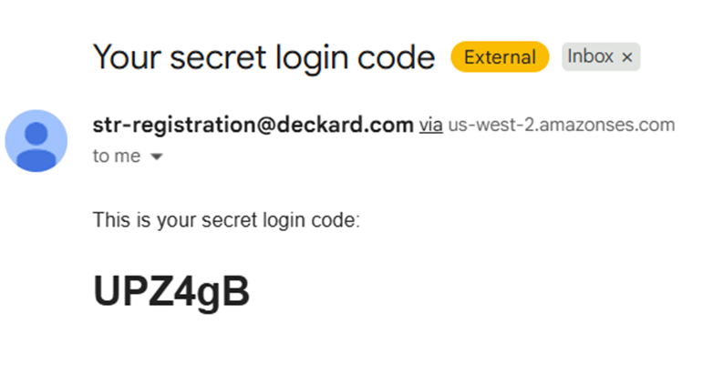
Updating License Information
Check your email for a verification code that looks something like this.

Slide 5

Updating License Information
Copy and paste code into field and click submit.

Slide 6
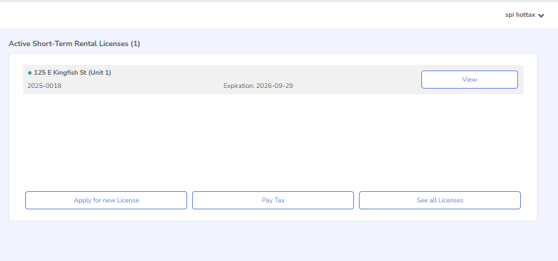
Updating License Information
Click on View

Slide 7
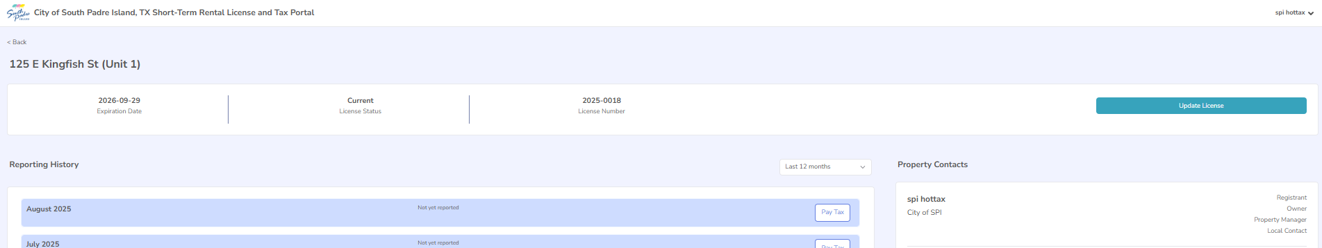
Updating License Information
Click on
“Update License” Button

Slide 8
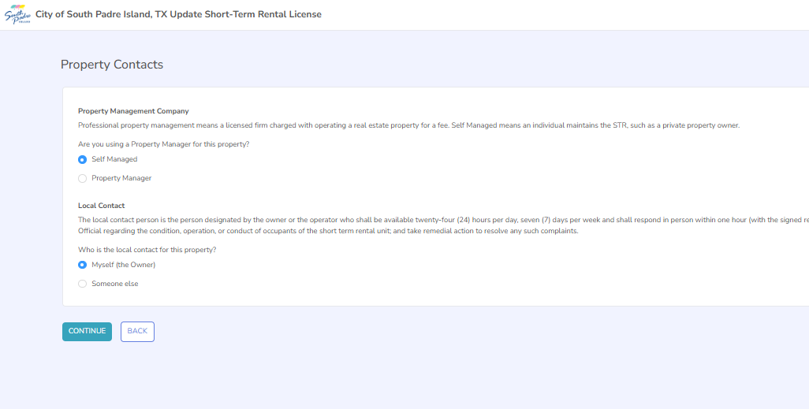
Updating License Information
Here you can make changes to property manager and/or your local contact. Click “Continue” to move to next page.

Slide 9
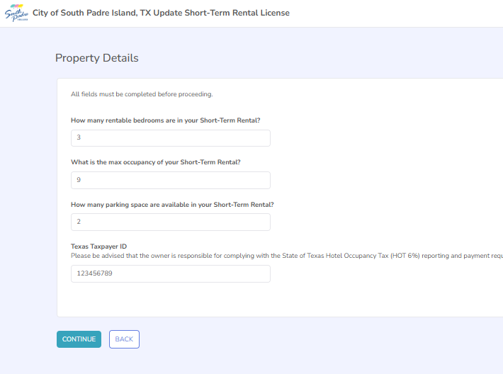
Updating License Information
Here you can change the information on Property Details. Click “Continue” to move to the next page.

Slide 10
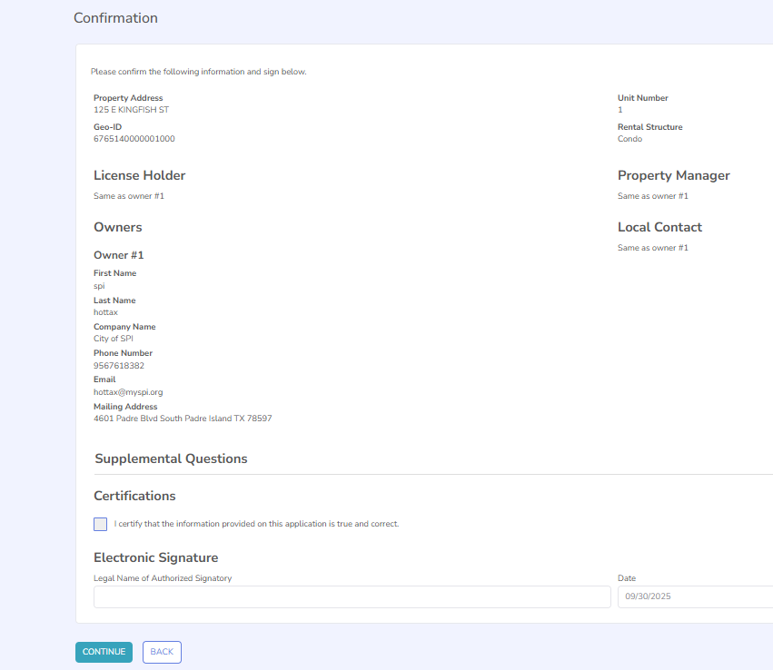
Updating
License
Information
Click on the Certification
Type in your name under Legal Name of Authorized Signatory
Click “Continue”

Slide 11
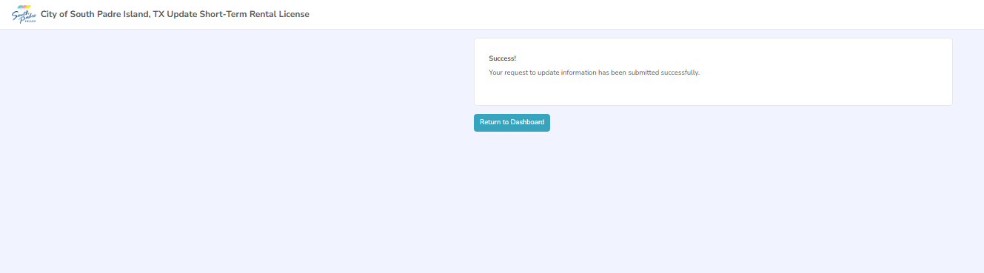
Updating License Information
Confirmation of update

Slide 12
Updating License Holder Information

Slide 13
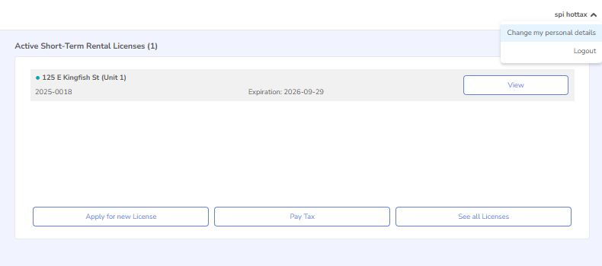
Updating License Holder Information
Property information used for training purposes only.
On your home screen on the top right hand corner click on your name and click on “Change my personal details”

Slide 14
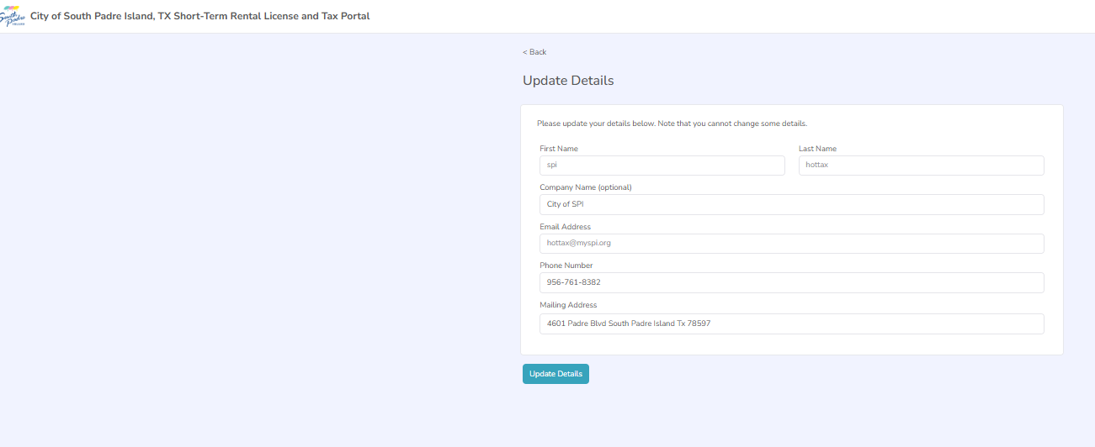
Updating License Holder Information
The only information that can be changed for the License Holder is Company Name, Phone Number and Mailing Address.
If you need to change the License Holder’s Name or Email Address please contact the City at 956-761-8382 to make that transfer of license.

Slide 15
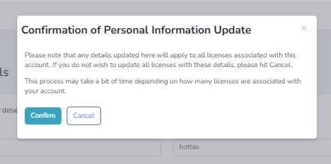
Updating License Holder Information
Please note that any changes confirmed here will apply to all the licenses associated with your account.
Click “Confirm” to update information.

